Slide 1
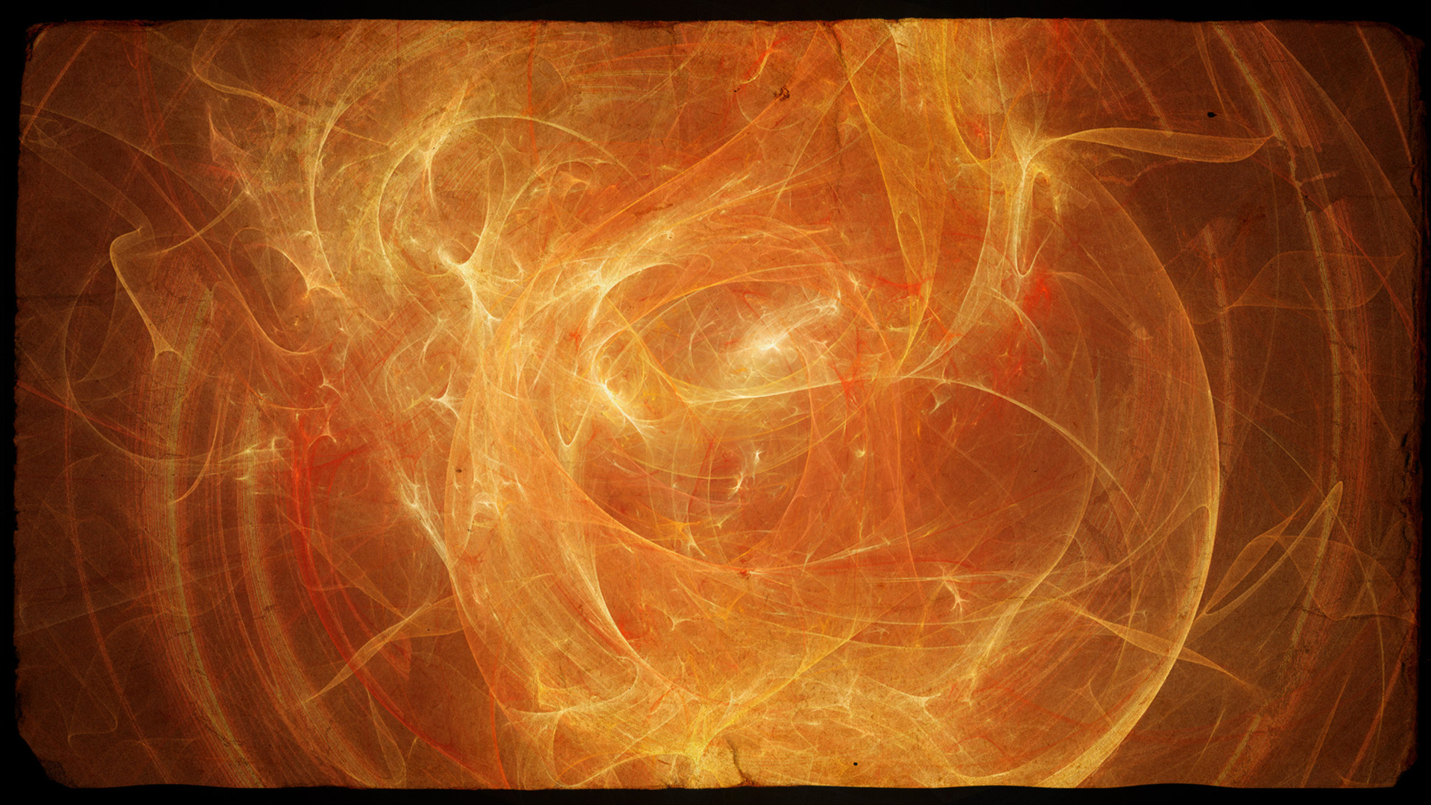


Slide 2

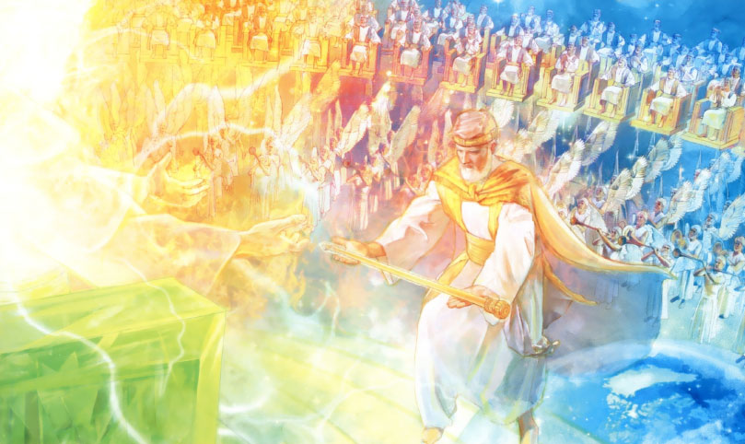
I. A Terrifying Truth!
Our Purpose in Life.
It is to bring glory to God!
  We only exist for
  God’s pleasure.
  God is looking for
  a family that will chose to love Him.
  Do your duty.
  The conclusion?

Slide 3
I. A Terrifying Truth!
5. The implications of Dispensational Truth.
  The function of a steward (we’ll examine this later) is to MANAGE and to MULTIPLY the rich man’s investment.
  “stewardship” = Greek word is “oikonomia” also translated as “dispensation.”
  It is a church who is a FAILED STEWARD that is raptured to the Judgment Seat of Christ. (JSoC)

Slide 5


